Slide 1
Designing nanophotonic structures using conditional deep convolutional generative adversarial networks
Sunae So and Junsuk Rho
Presented by Rui Xiao
SCUT Machine Intelligence Laboratory
Nov 18, 2021

Slide 2
Contents
1
Background
2
Motivation
3
Proposed Method
4
Experimental Results
5
Conclusion

Slide 3
Contents
1
Background
2
Motivation
3
Proposed Method
4
Experimental Results
5
Conclusion

Slide 4
Inverse Design of Metamaterials
Progress in nanophotonics has yielded numerous extraordinary optical properties.
Conventional design method requires time-consuming iterative simulations.
Recently, data-driven design approaches have been proposed to overcome this problem.
Most recently, a generative adversarial network (GAN) model has been used to inversely design metasurfaces.

Slide 5
Contents
1
Background
2
Motivation
3
Proposed Method
4
Experimental Results
5
Conclusion

Slide 6
Motivation
Motivation of cDCGAN
we provide the first use of a conditional deep convolutional generative adversarial network (cDCGAN) to design nanophotonic structures.
cDCGAN is a recently developed algorithm to solve the instability problem of GAN, and provides a very stable Nash equilibrium solution.
The research provides designs of a 64 × 64 pixel probability distribution function (PDF) in a domain size of 500 nm × 500 nm.

Slide 7
Contents
1
Background
2
Motivation
3
Proposed Method
4
Experimental Results
5
Conclusion

Slide 8
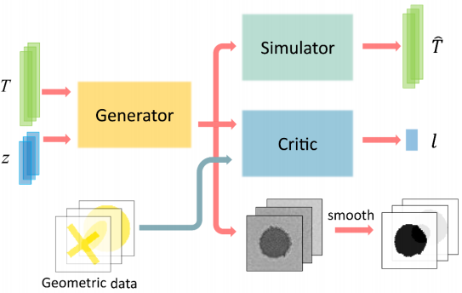
Overview
simulator (S)
generator (G)
critic (D)
All three networks are convolutional neural networks with delicate differences in detailed structures.

Slide 9
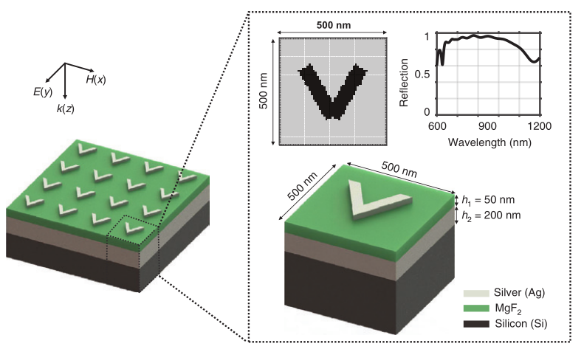
Data Preparation
we first collect a dataset consisting of 10,150 silver antennae with six representative shapes (circle, square, cross, bow-tie, H-shaped, and V-shaped).
Each entry in the dataset is composed of a reflection spectrum with 200 spectral points and its corresponding crosssectional structural design with a 64 × 64 pixel image.
A finite-difference time-domain (FDTD) electromagnetic simulation is performed using the commercial program FDTD Lumerical Solutions.

Slide 10
Data Preparation
we first collect a dataset consisting of 10,150 silver antennae with six representative shapes (circle, square, cross, bow-tie, H-shaped, and V-shaped).
Each entry in the dataset is composed of a reflection spectrum with 200 spectral points and its corresponding crosssectional structural design with a 64 × 64 pixel image.
A finite-difference time-domain (FDTD) electromagnetic simulation is performed using the commercial program FDTD Lumerical Solutions.

Slide 11
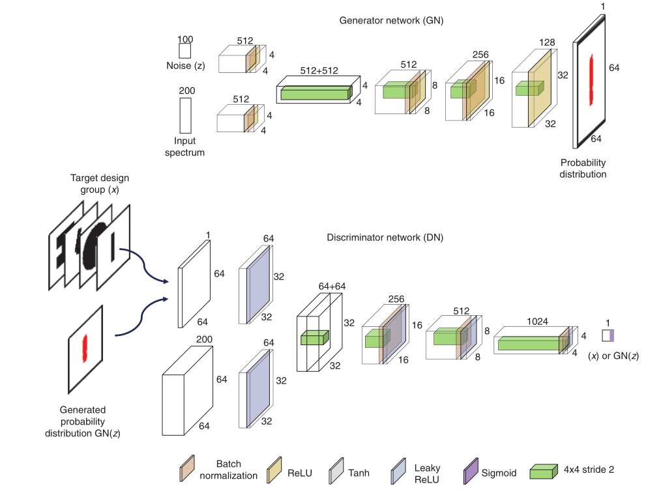
Schematic Of Architecture

Slide 12
Schematic Of Architecture
GN is composed of four transposed CNN layers consisting of 1024, 512, 256, 128, and 1 channel.
GN takes inputs of both the 100 × 1 size random noise (z) and the 200 × 1 size input spectrum.
GN provides a probability distribution function (PDF) of the antenna as output.
DN is a CNN with four layers.
DN takes input as a structural image from either a user-provided target designs group (x) or the generated PDF images by GN, GN(z).
DN distinguishes the generated images given by the GN from user-given target designs group.

Slide 13
Schematic Of Architecture
Mathematically, GN and DN are trained in the direction to minimize or maximize the objective function:
In terms of DN, the network is trained to give maximized expectation values of E
GN is trained to give minimized expectation values to deceive DN.This adversarial training allows GN to generate high-quality structural images.

Slide 14
Loss Function
we further modify the loss function of GN in the cDCGAN to fit our problem to:
ρ is the ratio of the adversarial loss.
is the design loss.
is the adversarial loss defined in Eq.

Slide 15
Loss Function
we further modify the loss function of GN in the cDCGAN to fit our problem to:
It directly measures the quantitative difference between two probability distributions of the target design ( ) and the generated design ( ) using a binary cross-entropy criterion:
Therefore, an appropriate value of ρ = 0.5 was chosen to maximize the ability of GN to produce convincing structural designs.

Slide 16
Proposed Method
To reduce the PDF to a binary image representing the existence of antennae at the locations, we employed a post-processing step according to Otsu:
Using a single GPU of GTX 1080-Ti, the training a network for one epoch requires about 4 min. However, once a network is trained, the trained network can generate a design for a desired spectrum within 3 s.

Slide 17
Contents
1
Background
2
Motivation
3
Proposed Method
4
Experimental Results
5
Conclusion

Slide 18
Simulation Results
The trained cDCGAN is evaluated on test data that were not used in the previous training or validation steps.
We introduce a mean absolute error (MAE) to quantitatively measure the average error.
The average MAE error of 12 test samples is 0.0322.
Even if the antennae have similar shapes, there can be a discrepancy between the predicted and input spectra.

Slide 19
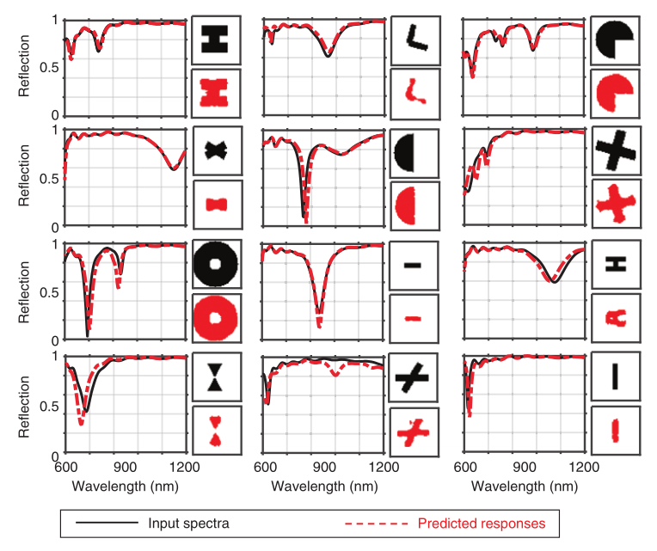
Simulation Results

Slide 20
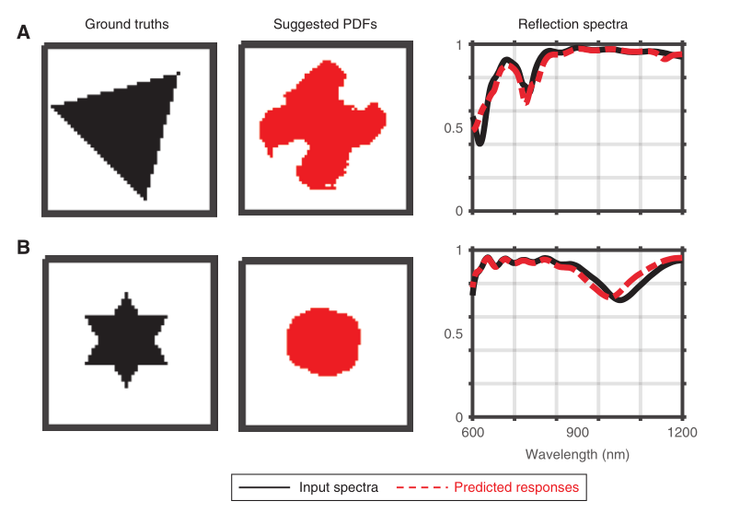
Experimental Results
cDCGAN suggestion results of completely new structures.

Slide 21
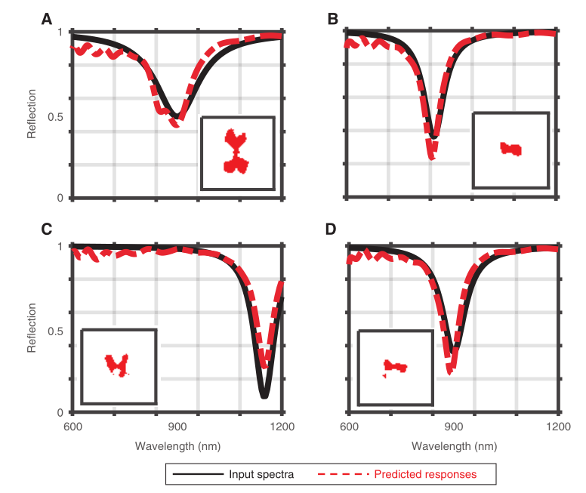
Experimental Results
Finally, our cDCGAN was further tested with randomly generated, hand-drawn spectra of the Lorentzianlike function.

Slide 22
Contents
1
Background
2
Motivation
3
Proposed Method
4
Experimental Results
5
Conclusion

Slide 23
Conclusion
Contributions
A cDCGAN is a recently developed algorithm to solve the instability problem of GAN, and provides a very stable Nash equilibrium solution.
Our cDCGAN is not limited to suggesting predefined structures but can also generate new designs.
Future work
Layer and the material type of the antenna can also be added as output parameters to be suggested.

Slide 24
Thank You
Thank You
Q&A

